Slide 1
Consulting on our draft methodology
for PR24
City briefing
7 July 2022

Slide 2
David Black Chief Executive

Slide 3
Agenda
15.00 Iain Coucher
15.05 David Black
15.15 Aileen Armstrong
15.40 Q&A
16.15 Close

Slide 4
Iain Coucher
Chair

Slide 5
David Black Chief Executive

Slide 6
Challenges and opportunities
Challenges
Cost of living
Environmental concerns
Legitimacy questions
Opportunities
Catchment-based approaches and nature-based solutions
Technology
Working with customers and business retailers to influence behaviour

Slide 7
Sewer flooding

Slide 8
Ofwat has a role in creating and allocating value
Creating value
Allocating value
Information and incentives
Customers eg affordability, service
Investors – maintaining confidence
Environment & resilience – addressing challenges
Increasing the size of the pie
Fair share of
the pie

Slide 9
Customer interest is much broader than the level of the bill
Quality of service
Resilience
Environment

Slide 10
Regulatory tools
Licence
Enforcement
Markets
Data and monitoring
Communications and influencing
Partnerships
Price reviews

Slide 11
Aileen Armstrong
Senior Director, Company Performance and Price Controls

Slide 12
Challenges and ambitions
Challenge: Rising customer expectations
Reflecting a clearer understanding of customers and communities
Challenge: Affordability concerns
Delivering greater environmental and social value
Focusing
on the long term
Driving improvements through efficiency and innovation
Challenge: Combatting climate change as well as protecting the environment and enhancing our natural resources

Slide 13
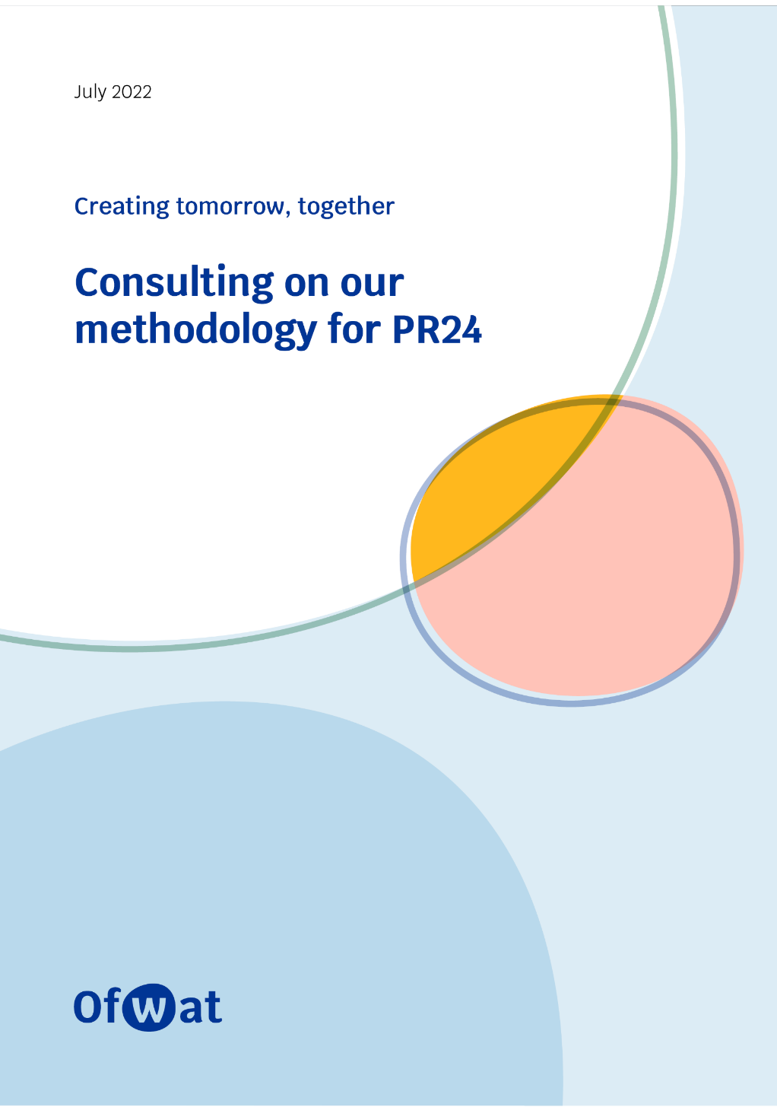
Methodology for PR24

Slide 14
Encouraging quality and ambitious business plans
Outstanding – sets the bar for others
+ 30 bps return on reg. equity reward
Protection from reductions in allowed return and base cost allowance
50:50 cost sharing
How ambitious is the plan?
Standard – generally good
0 to + 10 bps return on reg. equity reward
50:50 cost sharing
YES
Is the plan of sufficient quality?
Lacking ambition – improvements required
Up to - 30 bps return on reg. equity penalty
55:45 cost sharing
Inadequate – significant improvements required
- 30 bps return on reg. equity penalty
60:40 cost sharing
NO

Slide 15
Outcomes – proposed common performance commitments for PR24
 | Water and wastewater | Water only | Wastewater only
Customers receiving excellent service every day | C-MeX D-MeX BR-MeX [for English companies] Business customer satisfaction [for Welsh companies] | Water supply interruptions Compliance risk index (CRI) Customer contacts about water quality | Internal sewer flooding External sewer flooding
Environmental outcomes | Biodiversity | Leakage Per capita consumption Business demand Operational greenhouse gas emissions – water | Pollution incidents Serious pollution incidents Discharge compliance Bathing water quality River water quality Storm overflows Operational greenhouse gas emissions – wastewater
Asset health |  | Mains repairs Unplanned outage | Sewer collapses
{
}
New performance commitments highlighted in bold. All measures financially incentivised

Slide 16
Incentivising good outcomes
Aggregate sharing mechanisms
Customer share of underperformance payments (cumulative, £)
% RoRE
-5%
-3%
+3%
+5%
Customer share of outperformance payments (cumulative, £)

Slide 17
Costs
Efficiency is critical to affordability
Building on our PR19 approach to cost assessment
Greater use of benchmarking in our assessment of enhancement expenditure
Rapid improvements needed in the use of storm overflows
Progress on net zero and greenhouse gas emissions
Greater certainty around funding for nature-based solutions

Slide 18
Indicative PR24 RoRE ranges

Slide 19
Risk and return
Early view of the cost of capital in the final methodology
There may be a stronger role for equity in the notional capital structure
Fully transition to CPIH from April 2025
Business plans to be accompanied by Board assurance that plans are financeable
Final methodology to provide guidance for a narrow range of RCV run-off rates for each wholesale control
Stronger emphasis on financial resilience – with plans accompanied by Board assurance
Separate consultation to come on options to strengthen regulatory protections from risky financial structures
Companies to set out policies for dividends and performance-related executive pay and voluntary sharing mechanisms

Slide 20
Markets
Greater use of direct procurement for customers
Proposing to remove site-specific developer services (eg laying new water mains) from the price control where there is strong competition
Proposing more market-based regulation of bioresources. As part of this transition, we would provide a higher level of regulatory protection for pre-2020 bioresources RCV

Slide 23
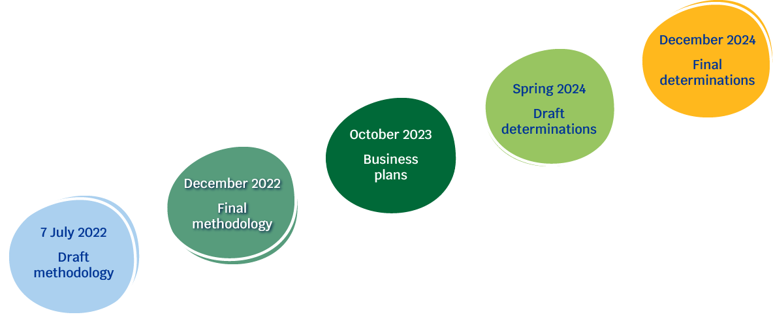
Next steps in the price review

