Slide 1
Outcomes working group
January 2023

Slide 2
Agenda
Item | Who | Time
Introduction and welcome | Jenny Humble | 5 mins
Recap on research approach | Simon Compton | 15 mins
Demand Update and discussion | Graham Knowles | 40 mins
BREAK |  | 10 mins
Asset Health Update and discussion | Jonny Baldry | 40 mins
Next steps and AOB | Jenny Humble | 10 mins

Slide 3
ODI Rates Research Design

Slide 4
Context
Company research at PR19 led to very widely divergent valuations
A more centralised approach has been adopted for PR24 in which Ofwat and CCW have worked with companies and stakeholders as part of the Collaborative Research
The main vehicle for capturing customer preferences has been the ODI Rates Research Survey:
  Household (HH) survey of at least 500 customers per company
    58% random sample from Postal Address File, 42% online panel sample
    Interviews completed July to September
  Non-household (NHH) survey of minimum of 200 customers per company
    Sample drawn from MOSL database with retailers adding contact details
    Interviews August to October
Survey data weighted and anonymised and used as inputs into econometric models.

Slide 5
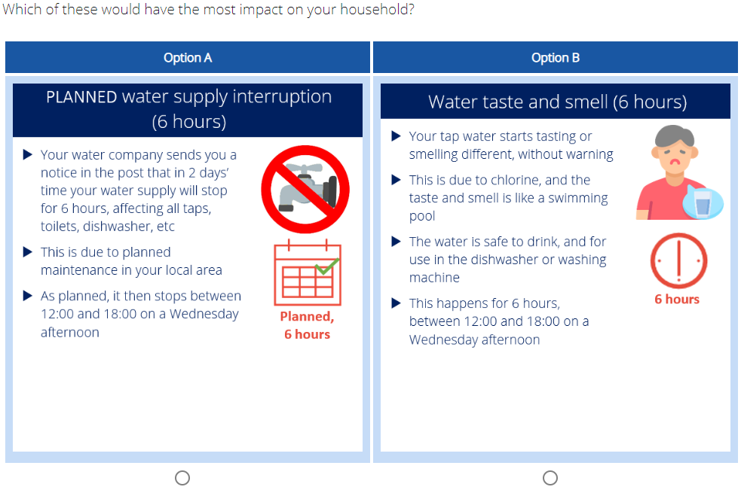
Survey choice questions - Impact Exercise
Survey respondents asked 8 questions in the format below, drawn from 26 service failure incident descriptions. Results were modelled to estimate the relative impacts of each of the 26 incidents

Slide 6
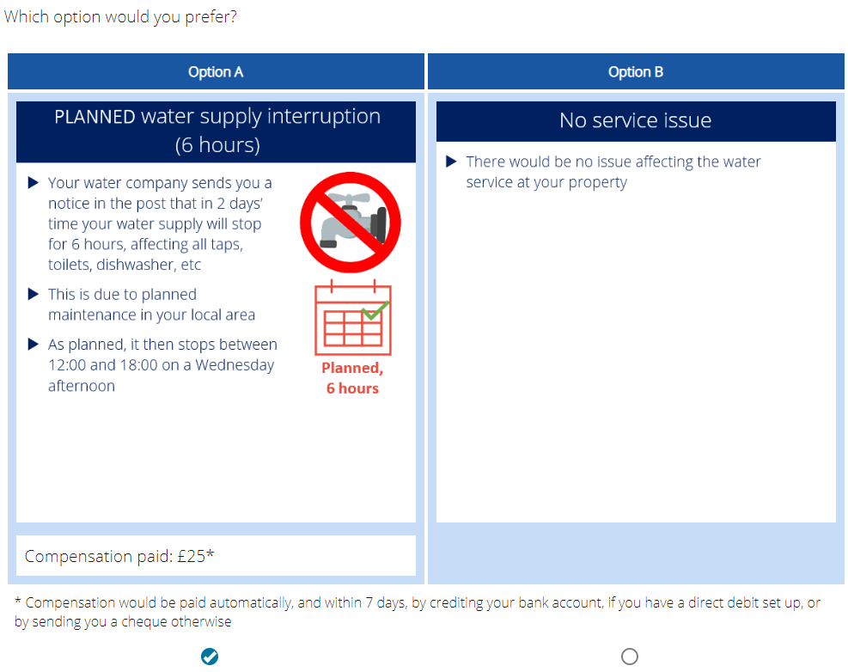
Survey Choice Questions - Compensation Exercise
Survey respondents were asked questions in the format below for two of the incidents – planned water supply interruption (6 hours) and boil water notice (48 hours). Results were modelled to estimate valuations for each of these two incidents

Slide 7
Combining Estimates
Service issue | Impact index |  | Value
Service issue | Base=PlannedInt6 | Base=BoilNotice | PlannedInt6=£50 | BoilNotice=£120
Planned interruption (6h) | 1 | 0.5 | £50 | £60
Boil water notice (48h) | 2 | 1 | £100 | £120
Unexpected interruption (24h) | 4 | 2 | £200 | £240
Internal sewer flooding | 20 | 10 | £1,000 | £1,200
Suppose average compensation required is estimated to be £50 for a planned 6 hour supply interruption and £120 for a 48 hour boil water notice
These two values combine with the relative impact estimates to create a set of value estimates8h)
of value estimates

Slide 8
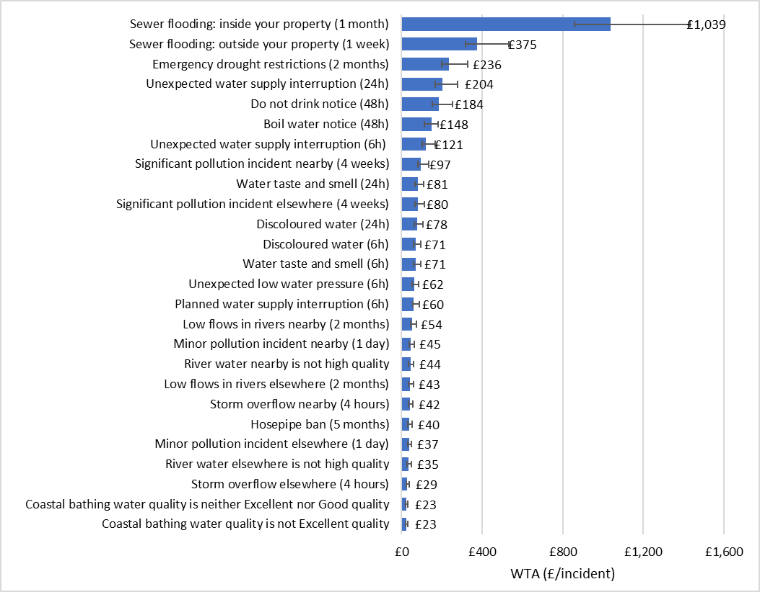
Core England and Wales valuation rates for households
Results show the weighted mean of the two sets of results for E&W (one for each pivot), and confidence ranges derived as the lower of the two lower bounds to the upper of the two upper bounds.
Relative values all in line with expectation, e.g.:
  Sewer flooding has highest impact
  Longer interruptions > shorter
  Unexpected interruptions > planned
  Do not drink > boil notice
  Significant pollution > minor
  Issues nearby > issues elsewhere in region
Relative impact of Boil notice (48h) to Planned interruption (6h):
  Relative compensation (SP2): 3.2
  Relative impact (SP1): 2.1

Slide 9
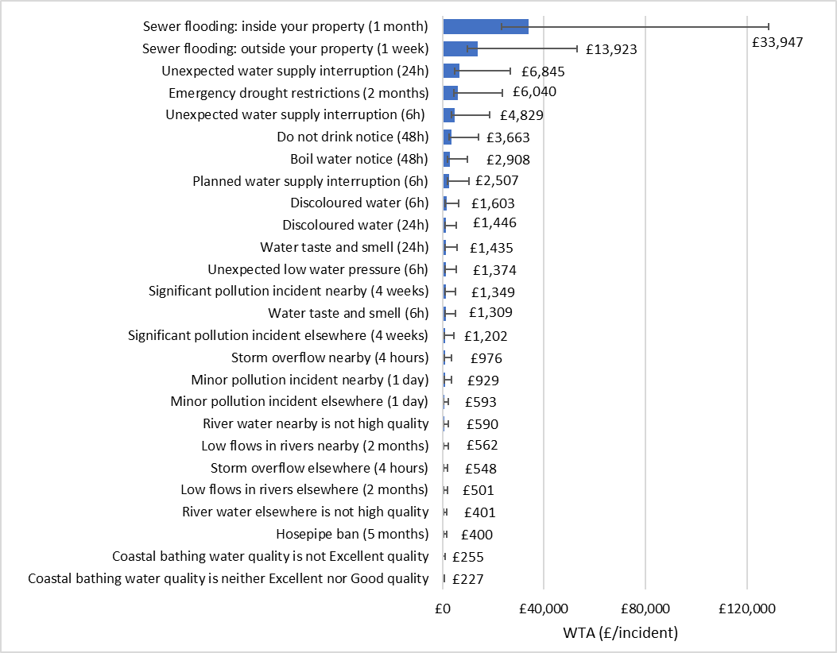
Core England and Wales valuation rates for non-households
Relative values still broadly in line with Relative Relative values still broadly in line with expectation, e.g.:
  Sewer flooding has highest impact
  Longer interruptions > shorter
  Unexpected interruptions > planned
  Do not drink > boil notice
  Significant pollution > minor
  Issues nearby > issues elsewhere in region
However: results are much less precisely estimated than for households
Relative impact of Boil notice (48h) to Planned interruption (6h):
    Relative compensation (SP2): 3.8
    Relative impact (SP1): 1.0

Slide 10
Indicative mapping for PR24 PCs
Customer facing PCs | Customer research valuations
Total water demand (leakage, PCC, business demand) Ml/d | Hosepipe bans Emergency drought restrictions Low flows in rivers nearby Low flows in rivers elsewhere
Customer contacts about drinking water quality Per 10,000 population | Discoloured water – 6 hours Discoloured water – 24 hours Taste or smell of water – 6 hours Taste or smell of water – 24 hours
Compliance risk index % | Boil water notice Do not drink notice
Water supply interruptions HH:mm:ss per customer | Planned interruption – 6 hours Unplanned interruption – 6 hours Unplanned interruption – 24 hours
Internal sewer flooding Per 10,000 connections | Internal sewer flooding
External sewer flooding Per 10,000 connections | External sewer flooding
Environmental PCs | Customer research valuations
Pollution incidents Per 10,000km of sewer | Minor pollution incident – nearby Minor pollution incident – elsewhere Significant pollution incident – nearby Significant pollution incident – elsewhere
Serious pollution incidents nr | Significant pollution incident – nearby Significant pollution incident – elsewhere
Discharge permit compliance % | River water quality not high – nearby River water quality not high - elsewhere
River water quality | River water quality not high - nearby River water quality not high - elsewhere
Bathing water quality | Bathing water quality - not excellent Bathing water quality - not good
Storm overflows | Storm overflow - nearby, 4 hours Storm overflow - elsewhere, 4 hours
Asset health PC | Other valuation techniques
Mains repairs Per 10,000km of mains | Inferred benefits/top-down – to discuss this session
Unplanned outage % | Inferred benefits/top-down – to discuss this session
Sewer collapses Per 1,000km of sewer | Inferred benefits/top-down – to discuss this session
Other PCs | Other valuation techniques
Biodiversity Units tbc | Expect to use external valuations
Operational greenhouse gas emissions tCO2e or % | Expect to use external valuations or marginal costs from bidding competition

Slide 11
Overall approach
£value for each service failure
Map the service failures in the survey to the final set of PCs
Calculate the marginal benefit estimates for each PC
Apply the “benefit sharing factor (x%)” to determine the appropriate ODI rates.

Slide 12
Demand

Slide 13
Indicative mapping: Demand
PC Definition | Reduction in leakage, PCC and business demand
Relevant service failures | Hosepipe bans Emergency drought restrictions Low flows in rivers nearby Low flows in rivers elsewhere
Valuation of a reduction of 1Ml/day of demand
Change in likelihood of a TUB with 10% change in demand
Total HH customer valuation of hosepipe ban (£)
Change in likelihood of a NEUB with 10% change in demand
Total NHH customer valuation of hosepipe ban (£)
Change in likelihood of emergency drought restrictions with 10% change in demand
Total customer valuation of emergency drought restrictions (£)
Equals
Multiplied by
Plus
Multiplied by
Plus
Multiplied by
Change in likelihood of drought permits with 10% change in demand
Total customer valuation of low flow nearby (£)
Change in likelihood of drought permits with 10% change demand
Total customer valuation of low flow elsewhere (£)
All divided by the number of ML/day associated with a 10% change in demand
Plus
Multiplied by
Plus
Multiplied by

Slide 14
Example of a simplified model (hosepipe ban)
Data extracted from APR
Data extracted from analysis of survey results
Data from company data request
Calculated from company data request
Change in likelihood of a TUB with 10% change in demand
Total HH customer valuation of hosepipe ban (£)
Number of ML/day associated with a 10% change in demand
Valuation of a reduction of 1ML/day of demand
Multiplied by
Divided by
Equals

Slide 15
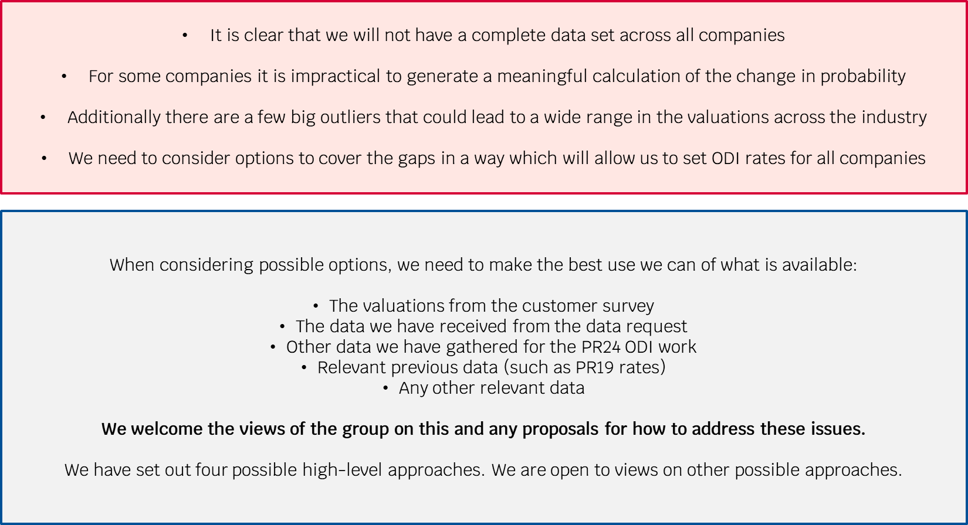
Data issues

Slide 16
Potential model options with pros/cons for discussion
 | Median value | National average | Regional average | Assessed rate (top down)
Description | Take the median probability from the available data to generate a valuation for companies with gaps. | Generate a weighted average (national average) from available probability data and apply to all companies with gaps. | Using regional planning areas, generate a weighted average (regional average) from available probability data and apply to all companies in each region with gaps. | Apportion maximum RoRE % to be applied to demand PCs. Use all available relevant data to centrally assess rates on a consistent basis across companies.
Pros | Simplest option. | Relatively simple and allows for separate English and Welsh averages. | May generate “fairer” valuations for companies with data gaps as neighbouring companies may face more similar probabilities. | Allows for consistency across other ODIs. Allows for wider contextual input. Less onerous for companies in terms of data (re)validation.
Cons | Issue of equitability – a company with a similar profile that has generated probabilities may end up with a very different ODI rate to one with the assessed rate. | Issue of equitability – a company with a similar profile that has generated probabilities may end up with a very different ODI rate to one with the assessed rate. | Regions don’t divide companies neatly (some companies cross regional boundaries). No specific Welsh region. Less available data to generate averages, which may cause distortions. | Would need to be applied across all companies (not just “gap” companies) to be applied fairly.
Notes | Option to use company specific customer valuations so all affected companies would have bespoke ODI rates. Alternatively, we could use national average customer valuations for affected companies. | Could be applied across England and Wales or separately for each. Two options (as with the median value option) for the use of customer valuation data for bespoke or national rates. | Regional customer valuations could be generated, but are not currently available. | Welcome views from stakeholders as to relevant data that should be included.

Slide 17
Breakout group
Feedback and next steps

Slide 18
Break

Slide 19
Asset health

Slide 20
Recap and Introduction
In the last OWG meeting we presented some initial thoughts on deriving marginal benefit values for the asset health PCs through the inferred benefits approach.
We invited feedback on our approach and the feasibility of receiving data to enable us to map asset health valuations to customer-facing PC valuations.
Based on this feedback and further thinking we have observed that, while the inferred benefits approach is possible, it comes with risks attached when applying across the sector.
Inferred benefits approach risks
Consistency of approaches to deriving relationships between asset health measures and customer-facing PC measures across companies – there is a risk that values vary significantly between companies
Data burden and timeline risks
Dependencies on customer-facing PCs: The aim of the inferred benefits approach is to reflect customer valuations There is a risk of some customer-facing PC marginal benefit valuations being derived from top-down approaches (e.g. demand valuation) Asset health PCs would no longer link to customer valuations
Given these risks, we are minded to use a top-down approach to derive rates for asset health PCs.
We want to use this session to test this proposal and to check that there are no other options that we should consider.

Slide 21
List of options to derive rates for asset health PCs
Inferred benefits (full mapping)
Inferred benefits (partial mapping)
Re-use PR19 rates
Top-down approach
Other options?

Slide 22
Inferred benefits approach – full mapping – data requirements
Asset health PC | Links to other PCs/valuations | Data requirements | Data request?
Unplanned outages | Demand | Peak week production capacity (Ml/d) | No
 | Water supply interruptions | Number of WSIs caused by an unplanned outage | Yes
Mains repairs | Water supply interruptions | Number of WSIs caused by a mains repair | Yes
 | Leakage | Volume of leakage caused by mains bursts (Ml/d) | Yes
 | Discolouration | Number of customers experiencing discolouration caused by mains burst | Yes
 | Low water pressure | Number of customers experiencing low pressure caused by mains burst | Yes
Sewer collapses | Internal sewer flooding | Number of ISF incidents caused by a sewer collapse | Yes
 | External sewer flooding | Number of ESF incidents caused by a sewer collapse | Yes
 | Total pollution incidents | Number of cat 1-3 pollution incidents caused by a sewer collapse | Yes
 | Serious pollution incidents | Number of cat 1-2 pollution incidents caused by a sewer collapse | Yes
Double counting | Per link to PC valuation | Number of asset health failures in future year(s) caused by past asset health failures (e.g. 1 sewer collapse in year 1 leads to 2 sewer collapses in year 2) | No
 | Per link to PC valuation | Proportion of PC incidents caused by asset health failure event (e.g. proportion of WSIs caused by mains repairs) | Yes

Slide 23
Inferred benefits approach – data requirements – risks explained
We have identified several risks related to issuing a data request:
Companies may measure these relationships in different ways, or not have any measurement
  This may lead to a wide range of values for these relationships
  Requiring a consistent method of measurement may be difficult and time-consuming for companies to implement
  There is a timeline risk of checking and processing data
Some relationships are much harder to measure than others e.g. volume of leakage caused by mains bursts
  This amplifies the risk above
The size of the data request may be difficult to deliver in the timeframe
  There is a timeline risk of receiving the data on time to achieve the May deadline
  There is a risk of compromising on quality when measuring relationships
Alternative mapping approach
We have considered a “partial mapping” approach where we reduce the number of links to customer-facing PCs.
This would reduce the amount of data requested
But it would undervalue the effect asset health failure has on customers

Slide 24
Inferred benefits approach – dependency on other PCs
Customer valuations from collaborative research
Customer-facing PC marginal benefit valuations
Asset health PC marginal benefit valuations
Mapping
Inferred benefits
The inferred benefits approach relies on mapping the valuations from customer-facing PCs to get a value that reflects customer valuations for asset health measures.
This approach requires these underlying customer-facing PCs to reflect the customer valuations from the collaborative customer research.
As we have seen with the demand valuations, there is a risk that some customer-facing PC marginal benefit valuations may not directly reflect customer valuations from the research.
If the marginal benefit valuations of the customer-facing PCs are derived from, e.g. a top-down approach, instead of being mapped to the customer valuations, the inferred benefits approach will no longer reflect customer valuations to the same extent.

Slide 25
Alternative approach – re-use PR19 rates
An alternative approach is to re-use the rates from PR19 for asset health PCs. These would be recalibrated to reflect new RCV.
Companies undertook many different approaches to deriving ODI rates for asset health PCs in PR19. This led to a large range of rates.
The overarching approach for PR24 is to be consistent with setting ODI rates. PR19 rates were not developed on a consistent basis.
PR19 rates may still be used as one input to inform setting PR24 rates.

Slide 26
Alternative approach – top-down proportion of RoRE
As stated in the final methodology for PR24, one option for deriving ODI rates is through a top-down approach.
1
Assign a maximum RoRE % to these PCs based on their relative importance to other PCs
2
Calculate a marginal ODI rate for each PC that would add up to this RoRE allocation
There are many ways this can be done. Some components/methods include:
Use historical rates and performance
Bound by natural limits of performance improvement (zero incidents)
Probability estimates for performance
Use conceptual mapping to link to importance of customer-facing outcomes
Benefits | Drawbacks
Consistent approach for all companies | More arbitrary valuation – not directly linked to customer valuations
Avoids data request
Simple methodology – transparency of approach

Slide 27
Other approaches
We invite any thoughts on other approaches that we should consider as an alternative to a top-down approach.
Any approach would need to be applied consistently across all companies and would need to fit into suitable timeframes.

Slide 28
List of options to derive rates for asset health PCs
Inferred benefits (full mapping)
Issue full data request for links between asset health PCs and customer-facing PCs
Large data burden and risk of inconsistent approaches
Reliant on customer-facing PC values reflecting customer valuations from research
Inferred benefits (partial mapping)
Reduce the number of customer-facing PCs being linked to asset health PCs
Issues around consistency and reliance on customer-facing PC valuations remain
Moves further away from reflecting customer valuations
Re-use PR19 rates
Base PR24 rates for asset health PCs off PR19 rates
Adjust rates based on updated RCV
Valuations follow varied approaches to asset health ODI rates from PR19
Top-down approach
Set maximum amount of % RoRE to be assigned to asset health PCs, divide % RoRE by performance increment for rate
Use multiple inputs to inform rate – PR19 rates and performance, relative importance to other PCs, best-worst performers
Other options?
Should any other options be considered?

Slide 29
Breakout group
Feedback and next steps

Slide 30
Next Steps and Timeline

Slide 31
Timeline
Indicative marginal benefits for Batch 1 PCs
Indicative marginal benefits for Batch 2 PCs
Indicative marginal benefits for Batch 3 PCs
Dec 2022 | Jan 2023 | Feb 2023 | Mar 2023 | Apr 2023 | May 2023
Batch 1
Internal sewer flooding
External sewer flooding
Customer contacts about drinking water quality
Bathing water quality
Pollution incidents
Serious pollution incidents
Storm overflows
Batch 2
Total water demand (leakage, PCC and business demand)
River water quality
Discharge permit compliance
Water supply interruptions
Compliance risk index
Batch 3
Unplanned outages
Mains repairs
Sewer collapses
Data request due
Final analysis of survey results expected

Slide 32
Next steps
Batch 1
Testing indicative rates against PR19 rates and external sources where appropriate
Due to share indicative rates at Feb OWG meeting
Batch 2
Continue analysis for CRI and river water quality PCs
Develop and refine options for demand mapping
Due to share indicative rates at Mar OWG meeting
Asset health PCs
Reflect on feedback from OWG and develop next steps and timeline
General
Agree date for March OWG meeting
Feb meeting booked for 28th Feb 2023

