Slide 1
RAPID gate 2 schematics
June 2023

Slide 2
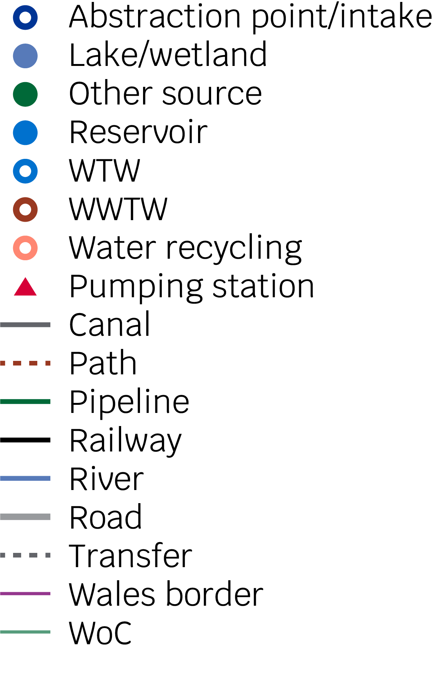
Gate 2

Slide 3
Gate 2

Slide 4
Gate 2

Slide 5
Gate 2

Slide 6
Gate 2

Slide 7
Gate 2

Slide 8
Gate 2

Slide 9
Gate 2

Slide 10
Gate 2

Slide 11
Gate 2

Slide 12
Gate 2

Slide 13
Gate 2

Slide 14
Gate 2

Slide 15
Gate 2

Slide 16
Gate 2

Slide 17
Thank you

