Slide 1
BR-MeX Working Group
MPF metrics
Ofwat
9th February 2024

Slide 2
Aim of the session and agenda
This workshop aims at advising the development of the BR-MeX incentive for PR24 and the question of the inclusion of MPF metrics. The aim of this session is to:
Recap thoughts from 14th December 2023 workshop
Outline amendments to the set of principles
Gather views and feedback on possible narrowing field for suitable MPF metrics for possible inclusion within BR-MeX
We will publish both the slides and a summary of the meeting on our website.

Slide 3
Recap from 14th December 2023 Industry Workshop

Slide 4
Recap - Objectives and criteria for assessing suitability of MPF activities and metrics for possible inclusion within BR-MeX
We have the following key considerations in mind for BR-MeX:
Wholesalers need a stronger focus on understanding the needs and requirements of business customers – the quality of wholesale services can materially affect the business customer experience
We will consider whether key measures of wholesaler performance in the business retail market (eg. one or more key metrics on data quality arising from the MPF reform programme) should complement B-MeX and R-MeX
The aim of the MPF Reform programme is to create a performance framework that is simpler and more effective that the existing MPF – with eight success criteria:
1
Facilitate Improved Customer Outcomes
2
Improve Trading Party Accountability
3
Support Competition
4
Consistency & Compatibility with Regulatory Regime
5
Enduring and Agile
6
Transparent and proportionate
7
Value for money
8
Simplicity
§2 MOSL: Market Performance Framework (MPF) Reform 17th August 2023
With the above in mind, we suggested that choice and use of any MPF metrics or KPIs within BR-MeX should be guided by the following draft principles (next slide):

Slide 5
Recap - Objectives and criteria for assessing suitability of MPF activities and metrics for possible inclusion within BR-MeX
DRAFT Principle – Metrics should: | DRAFT Description – the metric or KPI should:
1. Relate to end-customer service | capture something meaningful and significant about the effect on the end customer experience.
2. Say something meaningful about wholesaler performance | allow something meaningful to be said about a wholesaler’s (relative) performance so as to enable a meaningful out- or under-performance payment
3. Be sufficiently within wholesaler control | be largely (but not necessarily entirely) within the control of the wholesaler. This could include that the metric is provided sufficiently frequently and within a sufficiently short period of time so a wholesaler can understand and rectify their performance, if need be
4. Not be reproduced elsewhere as ‘double jeopardy’ | not be subject to financial penalties (including any compensatory payments) elsewhere, including within the MPF
5. Be accurate and verifiable | be clearly measurable, capably of being accurate and verifiable, and within a framework of challenge
6. Be consistent with relevant rectification / assurance process | be framed within a process that enables challenge, assurance and rectification, within the MPF process or the BR-MeX process, or a suitable dovetailing of the two.
7. Be ‘future proof’ | as much as possible be unlikely to change over the next AMP, including in terms of definition and retention within the MPF
8. Not be ‘game-able’ | as far as possible not be subject to ‘gaming’ or manipulation by a wholesaler.
SUGGESTED REVISED Principle – Metrics should: | Description – the metric or KPI should:
(A) Relate to end-customer service | capture something meaningful and significant about the effect on the end customer experience, and be ‘stretching’ (ie. we shouldn’t be rewarding Wholesalers for ‘BAU’) including over time
(B) Wholesaler performance meaningful and controllable | be largely (but not necessarily entirely) within the control of the wholesaler (but not ‘game-able’ or subject to undue manipulation), and meaningful in terms of performance here affecting customers and the market,
(C) Proportionate | be proportionate, in that any financial incentive or penalty should be proportionate with respect to its the effect on customers or the market
(D) not be reproduced elsewhere as ‘double jeopardy’ | not be subject to analogous or parallel financial penalties elsewhere, including within the MPF
(E) be accurate and verifiable | be clearly measurable, capably of being accurate and verifiable, and within a framework of challenge and assurance
(F) be ‘future proof’ | as much as possible be unlikely to change over the next AMP, including in terms of definition and retention within the MPF
(G) Simplicity and transparency | be, all other things equal, simple and transparent to understand and implement.

Slide 6
Candidate MPF metrics

Slide 7
Candidate metrics
Ofwat are currently considering whether KPIs in these areas may be appropriate for inclusion within BR-MeX. The below follows MOSL’s MPF reform consultation 3 pre-read materials (here).bla
MOSL activity reference
A.6 Wholesalers should maintain asset and premises data
A.7 Wholesalers should maintain working and readable assets (ie. meters)
A.9 Wholesalers should resolve customer service requests in a timely manner
A.3 Ensure occupancy classification is accurate (both Retailer & Wholesaler)
MOSL key performance indicators
M12 Proportion of premises address data accuracy
M20 Proportion of consumption from cyclic non-market meter reads performed within the biannual or monthly SLA
M19 Cyclic non-market meter reads performed within SLA (biannual or monthly)
M21 Lateness of overdue cyclic non-market meter reads
M14 Proportion of meters with credible GIS coordinates
M15 Average lateness of failed SLAs for bilateral requests
M10 № Long Unread Meters (LUMs) with outstanding B5 or C1 bilateral request
M17 Average length of deferrals per ORID
M18 Proportion of SLAs for bilateral requests completed on time
M16 Proportion of Deferred ORIDs
M15 Average lateness of failed SLAs for bilateral requests
M17 Average length of deferrals per ORID
M18 Proportion of SLAs for bilateral Requests completed on time
M16 Proportion of deferred ORIDs
M13 Proportion of unassured long-term vacant (LTV) premises
A.8 Assets (incl. Smart Meters) to drive water efficiency (Wholesalers)
M02 Proportion of Smart meters read
M08 Proportion of consumption settled on actuals vs estimates for smart meters
See annex for re-ordered list of these 13 metrics

Slide 8
Shortlist MPF metrics?
Metric |  |  | Commentary | Assess
M15 | Average lateness of failed SLAs for bilateral Requests | Number of Business Days beyond the Bilateral Hub SLA where the SLA’s completion conditions have not been met by the Wholesaler, averaged across all SLAs. We aim to allow the data to be further segmented by C1 Requests, B5 Requests and all other Requests combined and by LLUMs. This metric is also used for activity A7. | These may act as complementary pair Perhaps worth narrowing M15 &M18 attention to B5 (repair or replace a meter) and C1(verify a supply) As a pair, tick many boxes? E.g. Within Wholesaler control B5 and C1 significant % of market and customer outcomes? Proportionate? Simple? Relatively future proof? | HIGH?
M18 | Proportion of SLAs for bilateral Requests completed on time | The proportion of Bilateral Hub SLAs that have been completed by the Wholesaler within prescribed SLA periods. We aim to allow the data to be further segmented by C1 Requests, B5 Requests and all other Requests combined. This metric is also used for activity A7.
M10 | Number of Long Unread Meters (LUMs) with an outstanding B5 or C1 bilateral transaction request | Number of all LUMs, including Legacy Long Unread Meters (LLUMs), where there is an outstanding/in flight C1 (supply point verification) or B5 (meter repair/replace) bilateral Request in the Bilateral Hub on that meter. | Enduring issues that relate to customer experience However - Unclear sufficiently within Wholesaler control? | MEDIUM?
M19 | Cyclic non-market meter reads performed within SLA (biannual or monthly | Proportion of non-market meters which, at the measurement date, remain within the SLA period since the last cyclic meter read. We aim to allow the data to be further segmented by number of meters, proportion of meters, biannual, monthly, occupied, vacant, internal, and external meters | These may act as complementary pair Customer issue for those customers affected However – relates to non-market reads, small volume in relation to market | MEDIUM?
M21 | Lateness of overdue cyclic non-market meter reads | The number of Business Days that the meter was late for a cyclic meter read. We aim to allow the data to be further segmented by number of meters, proportion of meters, biannual, monthly, occupied, vacant, internal, and external meters

Slide 9
Annex – Supporting information and data

Slide 10
Some supplementary data relating to question of possible use of M15 and M18
Completed Operational Performance Standard (OPS) SLAs for Bilateral Tasks ¹ | Unit | January 2023 to December 2023 | July 2023 to December 2023
Volume of completed OPS SLAs - bilateral hub | № | 102,885 | 56,627
Volume of completed OPS SLAs - bilateral hub and legacy ² | № | 155,975 | 81,739
Volume of completed B5-1 SLAs - bilateral hub ³ | № | 32,153 | 17,170
Volume of completed C1-1 OPS SLAs - bilateral hub ³ | № | 37,287 | 18,587
Volume of completed B5-1 SLAs - bilateral hub as % of bilateral hub volume | % | 31% | 30%
Volume of completed C1-1 OPS SLAs - bilateral hub as % of bilateral hub volume | % | 36% | 33%
TOTAL – B5 and C1 requests as proportion of all bi-lateral requests | % | 67% | 63%
Volume of completed B5-1 SLAs – bilateral hub as % of bilateral hub and legacy | % | 20% | 21%
Volume of completed C1-1 OPS SLAs - bilateral hub as % of bilateral hub and legacy | % | 24% | 23%
TOTAL – B5 and C1 requests as proportion of bilateral hub and legacy requests | % | 44% | 44%
¹ Source: OPS Dashboard on MOSL website. They include both retailer and wholesaler raised requests, and cover all wholesalers in England and Wales including NAVs. It only includes completed SLAs i.e. it does not include OPS SLAs where the status is 'open’.
² Legacy means Wholesaler self-reporting, which is being phased out.
³ There is only one SLA for process B5. There are four SLAs relating to the C1 process, one of which is a retailer SLA, and only one of the Wholesaler SLAs (C1-1) is treated as an OPS.

Slide 11
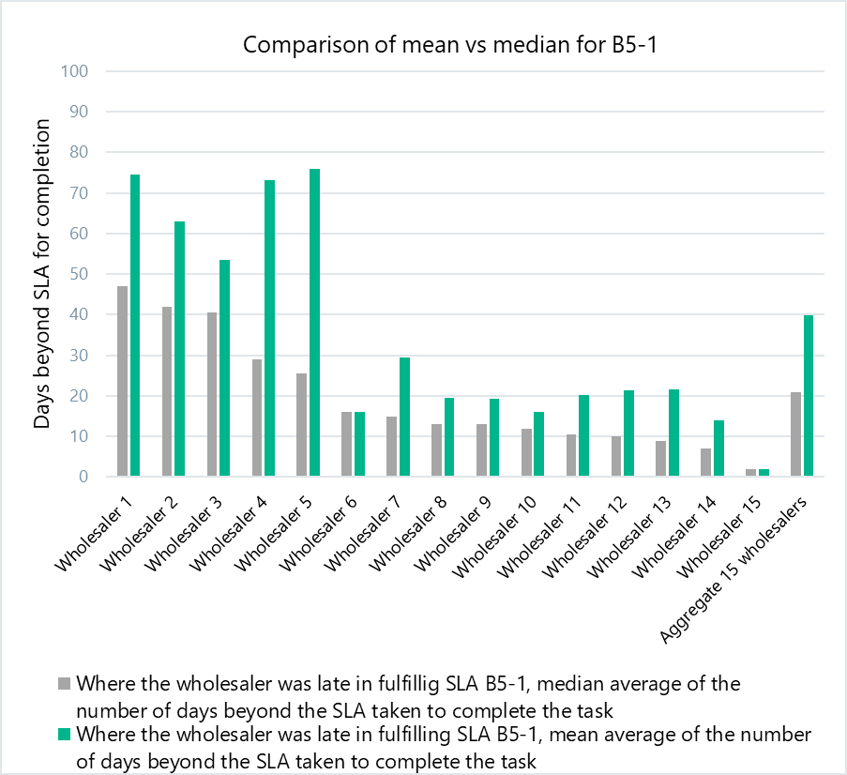
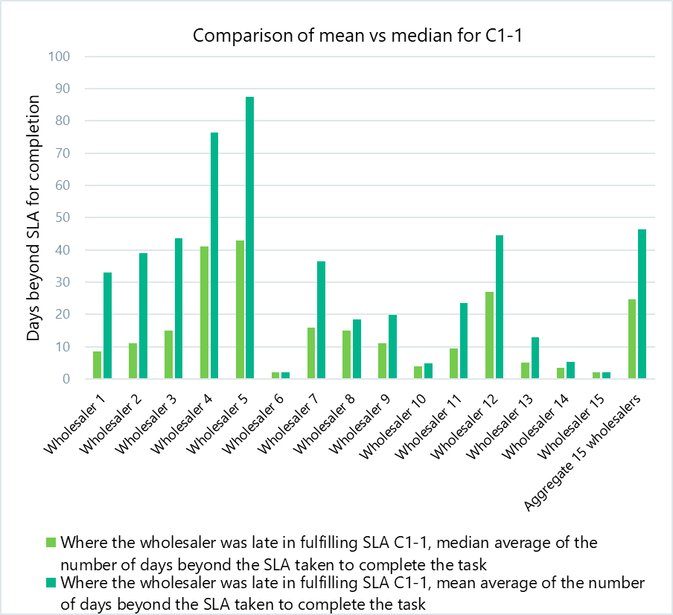
Wholesaler performance against B5 and C1

Slide 12
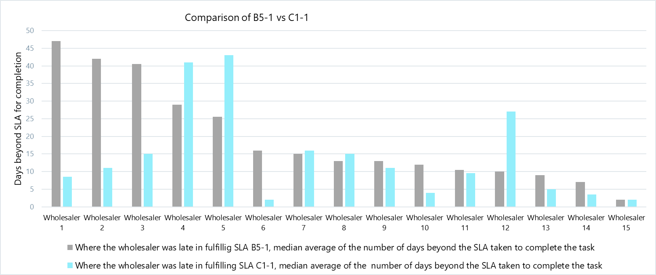
Performance B5-1 cf C1-1

Slide 13
Annex – List of 13 candidate MPF metrics for BR-MeX?
 |  | Metric name | Metric description | MPF programme standard tools?
A3 | M13 | Proportion of unassured long-term vacant (LTV) premises | Unassured long-term vacant premises as a proportion of all long-term vacant premises. | T4 Public peer comparison
A6 | M12 | Proportion of premises address data accuracy | The proportion of a Wholesaler’s portfolio of SPIDs where key data (supply addresses, Unique Property Reference Number [UPRN] and Valuation Office Assessment [VOA]) is complete and accurate as proportion of that Wholesalers’ total portfolio of SPIDs. This metric can only be framed as a KPI once a measure of data accuracy has been established through the market data cleanse programme. Until then it will be reported as a market metric. We aim to allow the data to be further segmented by proportion of SPIDs, SPIDs [X] months old or less (i.e. focus on new connections) and SPIDs more than [X] months. This metric is also used for activities A3 and A5 | T4 Public peer comparison
A6 | M14 | Proportion of meters with credible GIS coordinates | The number of meters with credible GIS coordinates as a proportion of all meters managed by the Wholesaler. GIS coordinates where there are potential data issues, meaning they could be inaccurate/erroneous, would be identified using defined criteria, inc GIS X/Y coor-dinates being far from the postcode centre, being at the UPRN centre, over 20 meters with the same coordinates etc. | T4 Public peer comparison
A6 | M19 | Cyclic non-market meter reads performed within SLA (biannual or monthly) | Proportion of non-market meters which, at the measurement date, remain within the SLA period since the last cyclic meter read. We aim to allow the data to be further segmented by number of meters, proportion of meters, biannual, monthly, occupied, vacant, internal, and external meters. | T4 Public peer comparison T5a Penalties and rewards T5b Compensation payments
A6 | M20 | Proportion of consumption from cyclic non-market meter reads performed within the biannual or monthly Service Level Agreement (SLA) | Consumption of non-market meters which, at the measurement date, remain within the SLA period since the last cyclic meter read. We aim to allow the data to be further segmented by number of meters, proportion of meters, biannual, monthly, occupied, vacant, internal, and external meters. | T4 Public peer comparison
A6 | M21 | Lateness of overdue cyclic non-market meter reads | The number of Business Days that the meter was late for a cyclic meter read. We aim to allow the data to be further segmented by number of meters, proportion of meters, biannual, monthly, occupied, vacant, internal, and external meters. | T4 Public peer comparison T5a Penalties and rewards T5b Compensation payments
A7 | M10 | Number of Long Unread Meters (LUMs) with an outstanding B5 or C1 bilateral transaction request | Number of all LUMs, including Legacy Long Unread Meters (LLUMs), where there is an outstanding/in flight C1 (supply point verification) or B5 (meter repair/replace) bilateral Request in the Bilateral Hub on that meter. | T4 Public peer comparison
A8 | M02 | Proportion of smart meters read | Proportion of smart meters that had the appropriate number of reads. The development of this KPI will need to consider code changes to confirm and clarify the underlying code obligations around responsibilities, definitions and processes for smart meters and meter reads. This would inform the ‘appropriate number of reads’ which will be defined as part of the design of this metric. | T4 Public peer comparison
A8 | M08 | Proportion of consumption settled on actuals vs estimates for smart meters | Tracks the proportion of consumption settled on actual vs estimated reads for smart meters at each settlement run (R1, R2, R3 and RF). The development of this KPI will need to consider code changes to confirm and clarify the underlying code obligations around responsibilities, definitions and processes for smart meters and meter reads. | T4 Public peer comparison
A9 | M15 | Average lateness of failed SLAs for bilateral Requests | Number of Business Days beyond the Bilateral Hub SLA where the SLA’s completion conditions have not been met by the Wholesaler, averaged across all SLAs. We aim to allow the data to be further segmented by C1 Requests, B5 Requests and all other Requests combined and by LLUMs. This metric is also used for activity A7. | T4 Public peer comparison T5a Penalties and rewards T5b Compensation payments
A9 | M16 | Proportion of deferred ORIDs | Proportion of ORIDs that have been deferred as a percentage of total ORIDs raised (in current month and across a rolling 12 months). We aim to allow the data to be further segmented by C1 Requests, B5 Requests and all other Requests combined. This metric is also used for activity A7. | T4 Public peer comparison
A9 | M17 | Average length of deferrals per ORID | The average lengths of deferrals on ORIDs in the Bilateral Hub. We aim to allow the data to be further segmented by C1 Requests, B5 Requests and all other Requests combined. This metric is also used for activity A7. | T4 Public peer comparison
A9 | M18 | Proportion of SLAs for bilateral Requests completed on time | The proportion of Bilateral Hub SLAs that have been completed by the Wholesaler within prescribed SLA periods. We aim to allow the data to be further segmented by C1 Requests, B5 Requests and all other Requests combined. This metric is also used for activity A7. | T4 Public peer comparison T5a Penalties and rewards T5b Compensation payments
See p18 MPF Reform Pre-consultation document Component 3 of 4: Tools 17th August 2023

